Slide 1


STEAM EDA
by Ghassan Alrehaili

Slide 2
Introduction
Design
Data
Algorithms
Tools
What this presentation covers
Agenda

Slide 3
This data provides information about games on steam store, such as number of owners and the price for every game etc. This data was gathered until around May 2019 it's includ most games on the store prior to that date.
Introduction

Slide 4

What are the most games that has the highest positive ratings?
What are the most genres based on the number of owners?
Does the games affect the number of owners if it's a Single-Player or Multi-Player?
Design
Does the games, if it's free or paid, affect on the number of owners?
**** ***** ***** *******

Slide 5


Data
More than 27000 rows.
It has 10 columns.
Clean data
Solutions
1- Recalculate owners.
2- Change columns type.
3- Outlier data.
4- Add new columns.
1- Take average owners.
2- The last 5 years.
3- add years columns and total profit.

Slide 6
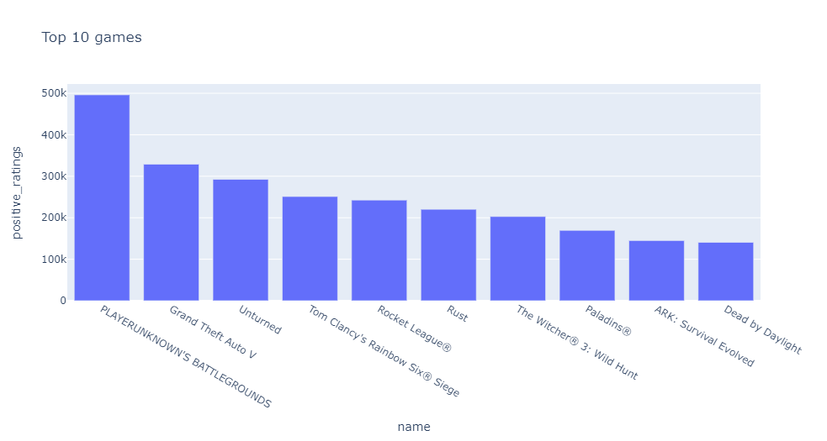
Most games with highest positive ratings?

Slide 7
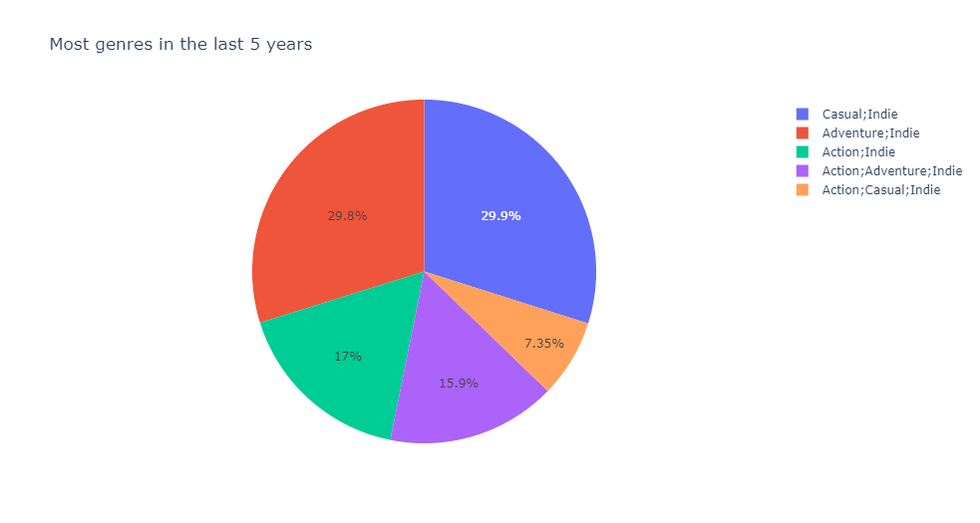
Most genres based on the number of owners

Slide 8
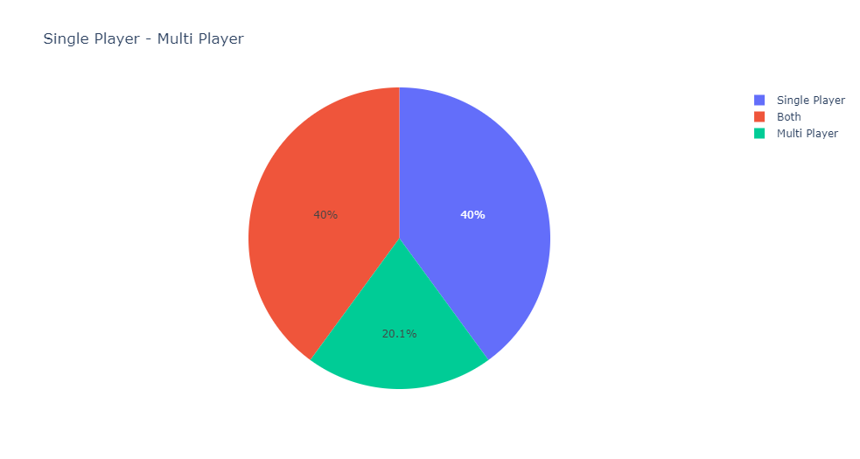
Number of owners and Single-Player or Multi-Player

Slide 9
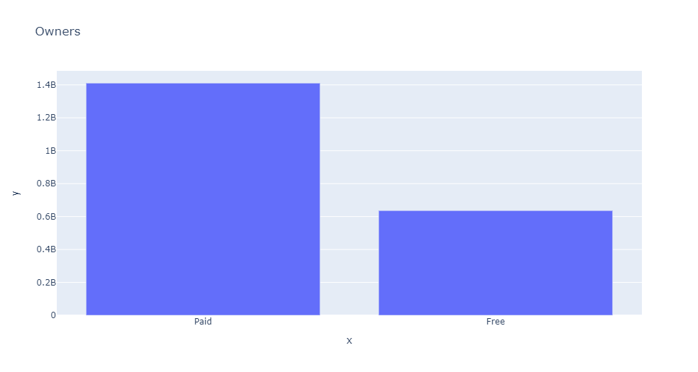
Free or paid and number of owners

Slide 10
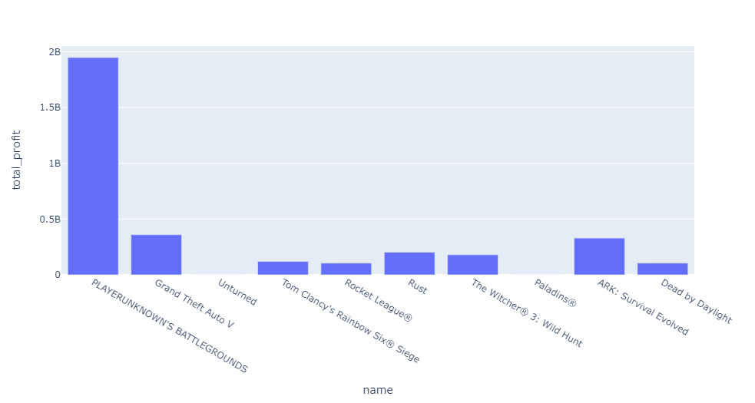
What about total profit?

Slide 11
1- Type of games in the next 5 years.
2- How much does it worth.
Conclusions

Slide 12
Jupyter Notebook
Tools
Libararies: numpy, pandas, seaborn, plotly.
Canva

Slide 13
Thank you!
Any questions?

